Slide 1


Part I
5. Process Redesign
Dimitris SACHARIDIS
2023-2024

Slide 2























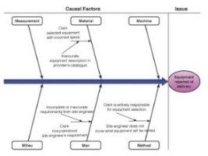
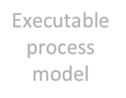

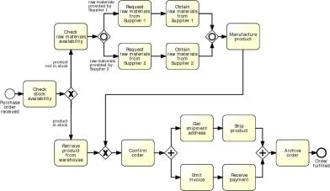






Process Redesign
Process
identification
Management Processes
Define Vision
Develop Strategy
Implement Strategy
Manage Risk
Core Processes
Procure Materials
Procure Market Deliver ^{Manage}
Products Products Products
Customer Service
35h
B
15h
30h
Process architecture
Support Processes
Manage Personnel
Manage Information
A
3m
D
E
30m 2h 10m
Conformance and performance insights
Manage Assets
5m
5m
C
1.5h
10m
Process discovery
15m
10min
As-is process model
Process monitoring
Process analysis
Executable process model
Insights on weaknesses and their impact
Process
implementation
Process
redesign
To-be process model

Slide 3
Process Redesign
1. Identify possibilities for improving the design of a process
2. any change to an existing process, be it minor or major, qualifies
3. Making changes to existing process does not have any hard and fast rule, requires creativity
4. Redesign heuristics can be used to generate ideas
AS-IS: Descriprive modelling of the real world
TO-BE: Prescriptive modelling of the real world

Slide 4
Process redesign approaches
Transformational Redesign
Puts into question the fundamental assumptions and principles of the existing process structure
Aims to achieve breakthrough innovation
Example: Business Process Reengineering (BPR)
Transactional Redesign
Doesn’t put into question the current process structure
Seeks to identify problems and resolve them incrementally, one step at a time
Example: Heuristic redesign

Slide 5
Business Process Reengineering (BPR)
Transformative: Puts into question the fundamental assumptions of the “as is” process
Analytical: Based on a set of principles that foster:
Outcome-driven processes
Integration of information gathering, work and decisions
5

Slide 6
The Ford Case Study
Ford needed to review its procurement process to:
Do it cheaper (cut costs)
Do it faster (reduce turnaround times)
Do it better (reduce error rates)
Accounts payable in North America alone employed > 500 people and turnaround times for processing POs and invoices was in the order of weeks
https://hbr.org/1990/07/reengineering-work-dont-automate-obliterate

Slide 7
The Ford Case Study
Automation would bring some improvement (20% improvement)
But Ford decided not to do it… Why?
Because at the time, the technology needed to automate the process was not yet available.
Because nobody at Ford knew how to develop the technology needed to automate the process.
Because there were not enough computers and computer-literate employees at Ford.

Slide 8
The correct answer is …
Mazda’s Accounts Payable Department
Mazda’s accounts payable team was about 5 people, versus a department of over 500 in Ford.
Even after considering differences of size, this was 5 times smaller than Ford.

Slide 9
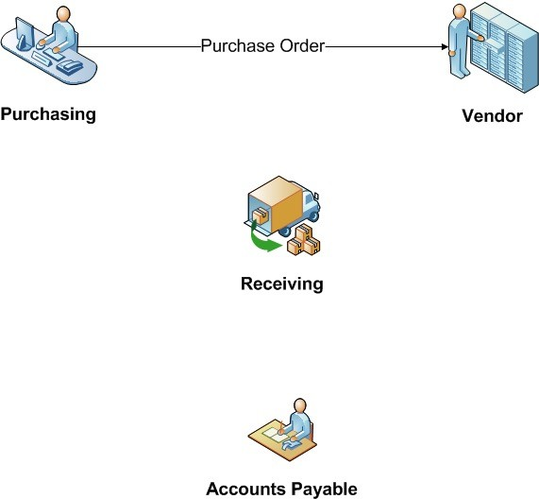
How the process worked? (“as is”)

Slide 10
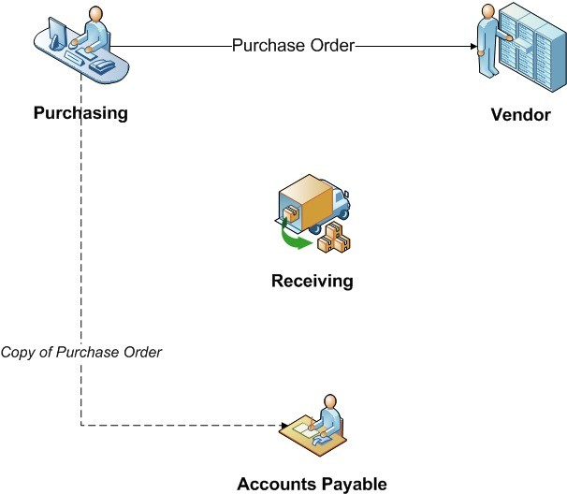
How the process worked? (“as is”)

Slide 11
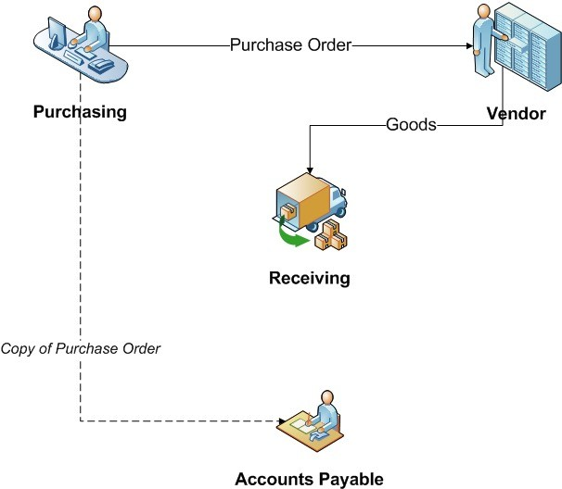
How the process worked? (“as is”)

Slide 12
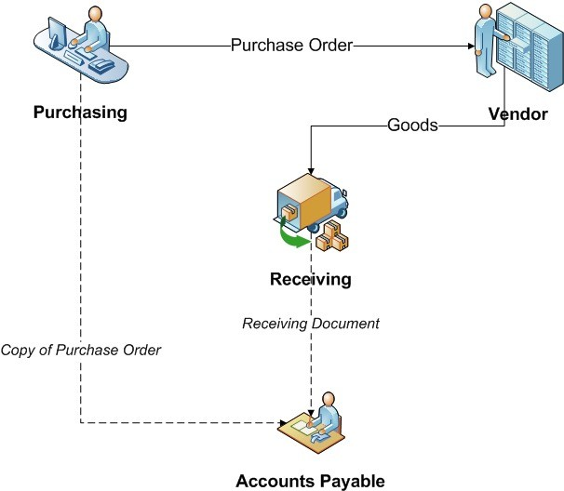
How the process worked? (“as is”)

Slide 13
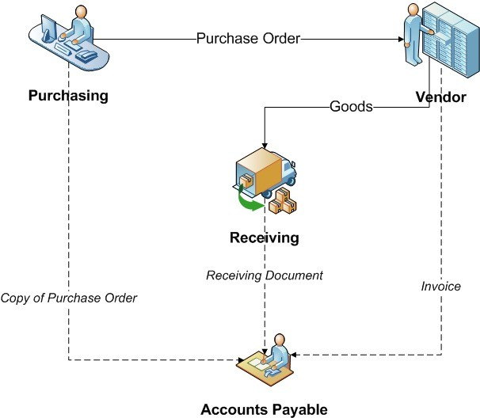
How the process worked? (“as is”)

Slide 14
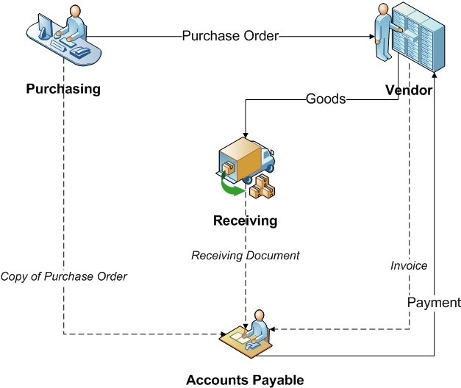
How the process worked? (“as is”)

Slide 15
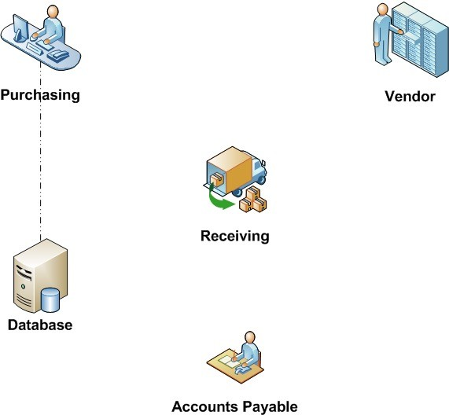
Reengineered Process (“to be”)

Slide 16
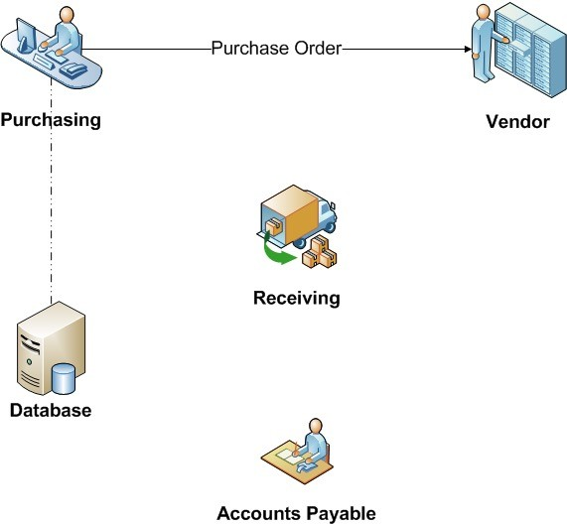
Reengineered Process (“to be”)

Slide 17
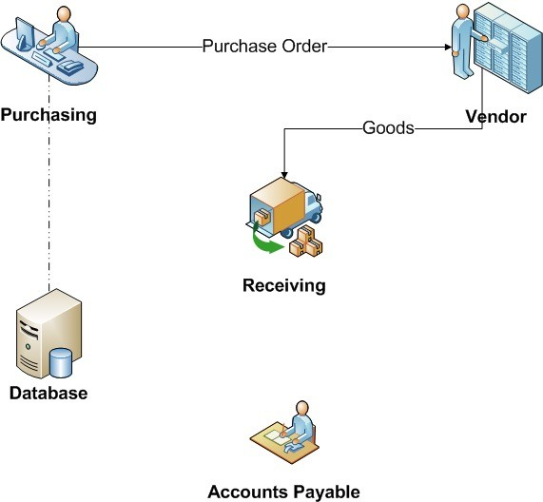
Reengineered Process (“to be”)

Slide 18
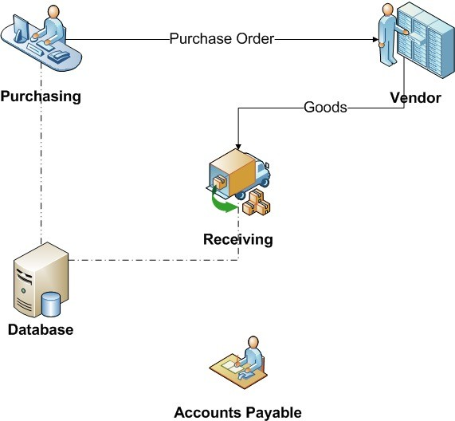
Reengineered Process (“to be”)

Slide 19

Reengineered Process (“to be”)

Slide 20
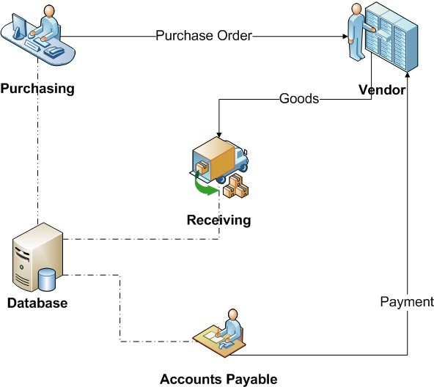
Reengineered Process (“to be”)
Evaluated Receipts Settlement

Slide 21
Outcome…
75% reduction in head count
Simpler material control
More accurate financial information
Faster purchase requisition
Less overdue payments
Lessons:
Why automate something we don’t need to do at all?
Automate things that need to be done.
Digitization vs. Digitalization
“Don’t Automate, Obliterate!” (Hammer, 1990)

Slide 22
Some principles of BPR
Capture information once and at the source
Subsume information-processing work into the real work that produces the information
Have those who use the output of the process drive the process
Put the decision point where the work is performed, empower workers to decide, and build control into the process
Treat geographically dispersed resources as though they were centralized.

Slide 23
Principle 1
Capture information once and at the source
Shared data store
All process workers access the same data
Don’t send around data, share it!
Self-service
Customers capture data themselves
Customers perform tasks themselves (e.g. collect documents)
23

Slide 24


Principle 2
Subsume information-processing work into the real work
Evaluated receipt settlement: when receiving the products, record the fulfillment of the PO, which triggers payment
24

Slide 25
Principle 3
Have those who use the output of the process drive the process
Vendor-managed inventory
Scan-based trading
Push work to the actor that has the incentive to do it
25

Slide 26





Example: problematic claims process
Authorize
Pay
Client
Claim
Insurer
Request quote
Approved glass vendor
Pay

Slide 27






Redesigned claims process
Client
Insurer
Claim
Pay
Approved glass vendor
Drop

Slide 28
Principle 4
Put the decision point where the work is performed, empower workers to decide, and build control into the process
Empower the process workers
Provide process workers with information needed to make decisions themselves
Replace back-and-forth handovers between workers and managers (transportation waste) with well-designed controls
28

Slide 29
Principle 5
Treat geographically dispersed resources as though they were centralized.
If same people perform the same function in different locations, integrate and share their work wherever possible
Larger resource pools → less waiting times even with relatively high resource utilization
29

Slide 30
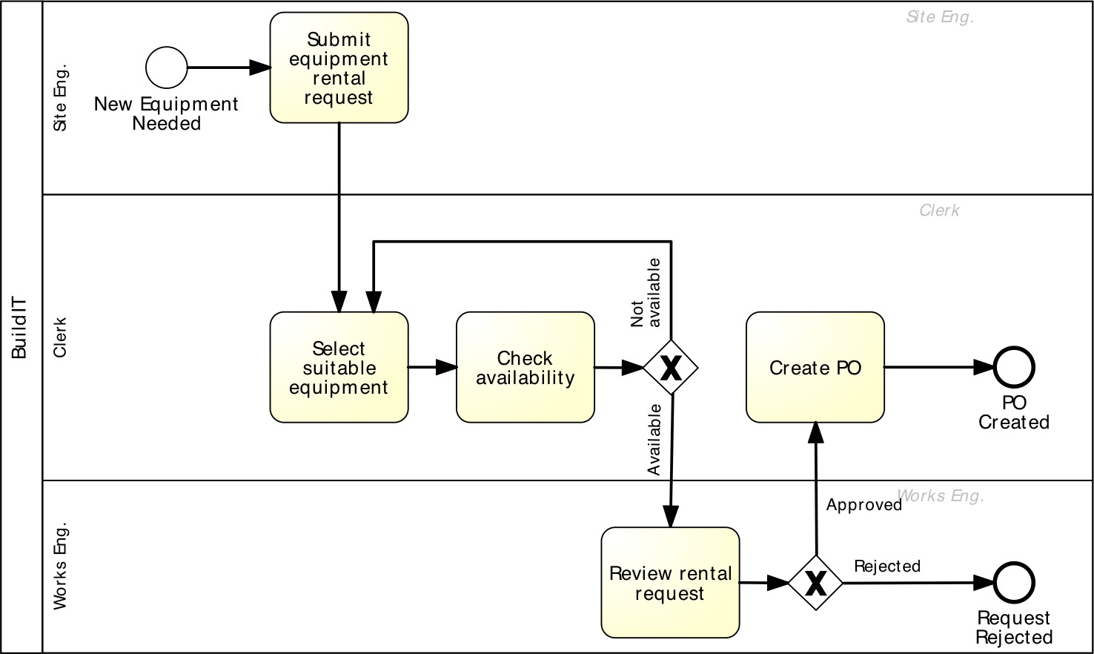
Example: Equipment rental process

Slide 31









Example: Self-service-based redesign
Principles 1 & 2
When equipment is needed, site engineer queries the suppliers’ catalogue, selects equipment and triggers PO
Principle 3
Supplier stocks frequently used equipment at construction site, site engineers scan to put them into use
Principle 4
Site engineer is empowered with the authority to rent the equipment; works engineer performs statistical controls
31

Slide 32
Process redesign approaches
Transformational Redesign
Puts into question the fundamental assumptions and principles of the existing process structure
Aims to achieve breakthrough innovation
Example: Business Process Reengineering (BPR)
Transactional Redesign
Doesn’t put into question the current process structure
Seeks to identify problems and resolve them incrementally, one step at a time
Example: Heuristic redesign

Slide 33
Heuristic process redesign
A method to identify changes to an “as is” process based on a collection of heuristics that strike tradeoffs between:
Cost
Time
Quality
Flexibility
33

Slide 34








Performance measures: the Devil’s Quadrangle
Cost
Time
Flexibility
Quality

Slide 35
Flexibility
Ability to react to changes in:
Workload
Customer demands and expectations
Resource and business partner availability and performance
Example: Following natural disasters (e.g. storms), the number of home insurance claims increases by tenfold
To address this surge, flexibility is required at:
Resource level: Staff redeployment, faster performance
Process level: Performing tasks differently to speed up the front-end
Management: Relaxing business rules and controls where possible

Slide 36
Redesign heuristics
Task elimination
Task composition/decomposition
Triage
Re-sequencing
Parallelism enhancement
Specialization & standardization
Resource optimization
Communication optimization
Automation
Task-level
Flow-level Process-level

Slide 37
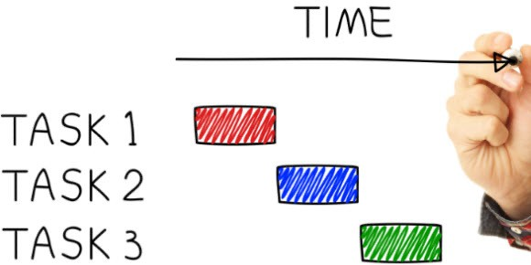
Task-level redesign heuristics
Task elimination
Task composition/decomposition
Triage

Slide 38



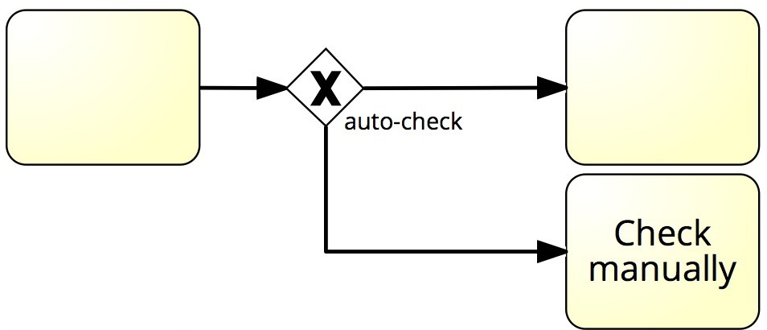

H1. Task elimination
Eliminate non-value-adding steps wherever these can be isolated
Forward, send, receive, …
Consider reducing manual control steps (checks & approvals) by:
Skipping them where feasible
Replacing them with statistical controls
Skipping them selectively. For orders of amount less than 1000, do not verify them and directly approve payment
+ Statistical Control
38

Slide 39
H1. Task elimination
(T+, C+/-, Q-)
Consider trade-off between the cost of the check and the cost of not doing it
Examples:
Procure-to-pay process: some types of employees are empowered to trigger isolated purchases below $500 without supervisor approval
Order-to-cash process: invoices from trusted suppliers under $1000 are not checked on a one-by-one basis
University admission process: authenticity check is very expensive, yet it leads to only 1% of applications being rejected
39

Slide 40






H2. Task composition/decomposition
Consider composing two tasks to eliminate transportation and reduce “context switches”, OR
Consider splitting a task into two and assign to separate, specialized resources

Slide 41
H2. Task composition and decomposition
Composition example:
Procure-to-pay process: Merging two checks: “Check necessity of purchase” and “Check budget”
Decomposition example:
Make-to-order process: Separate a single thick “prepare quote” task into “prepare bill of materials”, “prepare production plan” and “estimate costs and delivery time”
Composition: (T+, C+/-, F+) Decomposition: (T-, C+, F-)
41

Slide 42
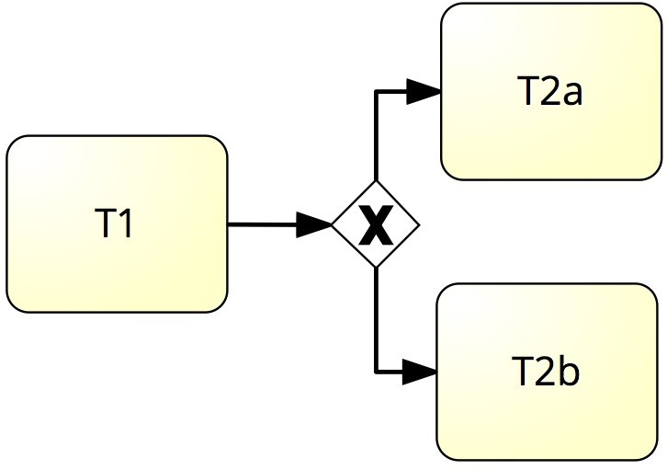
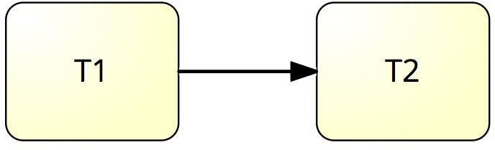




H3. Triage
Specialize a task: divide a general task into two or more alternative tasks
Generalize tasks: integrate two or more alternative tasks into one general task

Slide 43
H3. Triage
Specialization example:
Procure-to-pay process: Separate approvals of small purchases, medium
purchases and large purchases
Generalization example:
Make-to-order process: Integrate quote preparation for two product lines into one single task
Specialization: (T+, C+/-, F-) Generalization: (T-, C+/-, F+)

Slide 44

Flow-level redesign heuristics
Re-sequencing
Parallelism enhancement

Slide 45
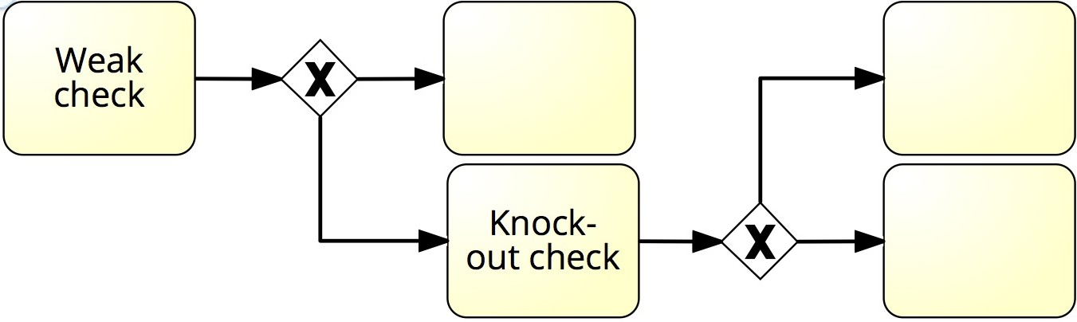


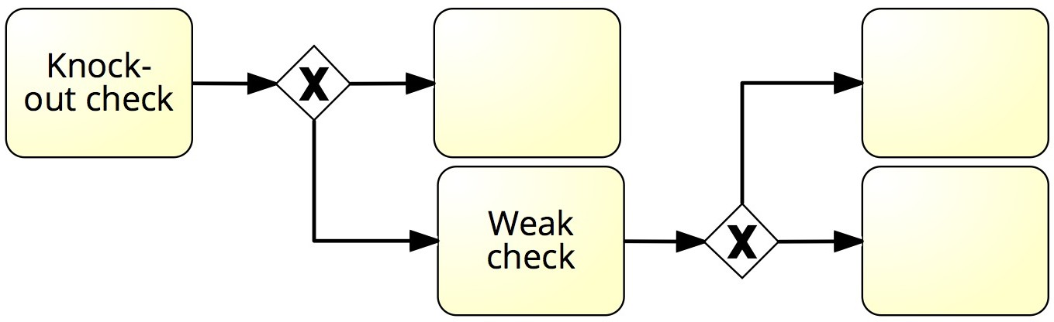
H4. Re-sequencing
Re-order tasks according to their cost/effect ratio to minimize over-processing
Postpone expensive tasks that may end up not being necessary until the end
Put knock-out checks first in order to identify problems early
45

Slide 46
H4. Re-sequencing
(T+,C+)
Examples:
Make-to-order process: If “Prepare production plan” is time-consuming, postpone it until after the quote price has been tentatively accepted by the customer
Procure-to-pay process: If “Check necessity of purchase” leads to 20% of knock-outs and “Check budget” leads to 2%, perform “Check necessity of purchase” first
University admission process: authenticity check (very slow) leads to 1% of applications being rejected while committee’s check leads to 80% of applications being rejected. Put committee’s check first
46

Slide 47



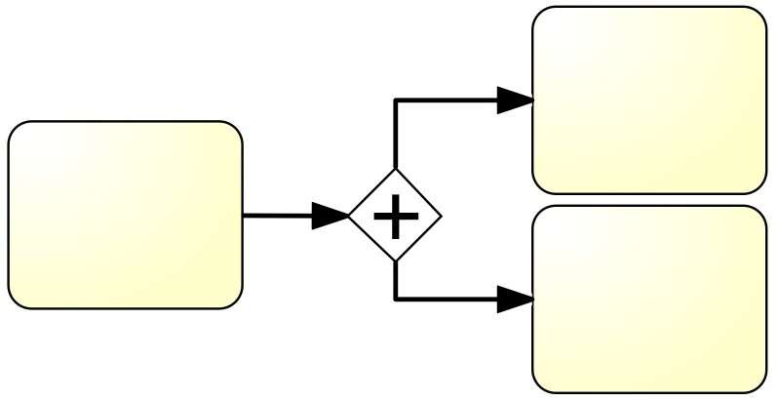
H5. Parallelism enhancement
Parallelize tasks where possible in order to reduce cycle time
47

Slide 48
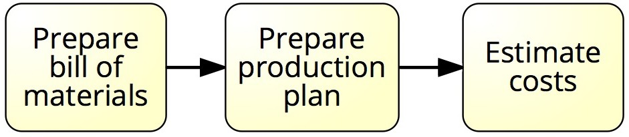


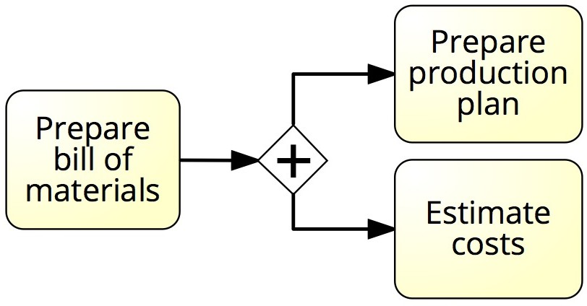
H5. Parallelism enhancement
(T+)
Examples:
Procure-to-pay process: Parallelize “Approve budget” and “Approve necessity of purchase”
Make-to-order process: After “Prepare bill of materials”, perform “Prepare production plan” and “Estimate costs” in parallel

Slide 49

Process-level redesign heuristics
Process specialization & standardization
Resource optimization
Communication optimization
Automation

Slide 50
H6. Process specialization/standardization
Process specialization
One process is split into multiple ones: by customer class, by geographic location, by time period (winter, summer), etc.
Resources are split accordingly
Process standardization
Two processes are integrated
Resources are pooled together

Slide 51
H6. Process specialization & standardization
Specialization example:
Procure-to-pay process: One process for Direct procurement (e.g. raw materials) and one for Indirect procurement (MRO - Maintenance, Repair and Operations)
Claims handling process: One claims handling process for the summer season (stormy season - peak) and one for the winter season (off-peak)
Standardization example:
Claims handling process: Integrate claims handling for motor insurance across different brands of a group
Specialization: (C+/-, Q+/-, F-) Standardization: (C+, Q+/-, F+)

Slide 52
H7. Resource optimization
Use resources of a given type as if they were in one room
Avoid one group of people overloaded and another (similar) group idle
Let people do work that they are good at
However, avoid inflexibility as a result of specialization
When allocating work to resources, consider the flexibility in the near future
If a task can be performed by both junior staff and senior staff, give that to senior so that junior is available for other work
Allocate work to specialized resources first
Avoid setups as much as possible (avoid context switching)
Chain multiple instances of the same task [sequential]
Batch multiple instances of the same task [parallel]

Slide 53
H7. Resource optimization
Resource integration example:
Claims handling process: Share resources across different types of claims (e.g. motor and personal insurance)
Batching example:
Claims handling process: Batch all claims for a given geographic area and assign them to the same resources
University admission process: Batch all applications and handle them to the assessment committee
(T+, C+, F+/-)

Slide 54
H8. Communication optimization
Minimize communication as much as possible
When information is being passed from one resource to another, provide as much detail as possible so that it is needed to have further communication
Automate handling, recording and organization of messages
Monitor customer interactions, record exceptions Optimize
Number of interactions with customers and business partners
Type of interaction (synchronous vs. asynchronous)
Timing of interactions
(T+,Q+,C+/-,F-)

Slide 55
H8. Communication optimization
Optimize number of interactions
Gather sufficient information to get to the next milestone (reduce external interactions)
Optimize type of interaction
Synchronous interactions effective to resolve minor defects
Asynchronous to notify, inform, resolve major defects, request additional information to reach next milestone

Slide 56
H8. Communication optimization
3. Optimize timing of interactions:
Front-loaded process: bulk of information exchange and processing happens upfront
Complete-kit concept
Back-loaded process: bulk of information exchange and processing happens downstream
Example: Ford procurement process in the late 80s

Slide 57
H8. Communication optimization
Complete-Kit Concept: “Work should not begin until all pieces necessary to complete the job are available”
Boaz Ronen
Principles for complete-kit process design:
Provide complete and easy-to-follow instructions for those who will initiate the process.
If a process cannot start, the client should be notified of all defects that could be reasonably identified at the onset of the process
Consider the tradeoff between “incomplete-kit” process initiation vs. roundtrip to revise and resubmit a request

Slide 58
H9. Automation
Use data sharing (Intranets, packaged enterprise systems) to:
Increase availability of information to improve visibility and decision- making (subject to security/privacy requirements)
Avoid duplicate data entry and transportation
Use network technology to:
Replace physical flow (e.g. paper documents) with information flow
Enable self-service via e.g. online forms and Web data services

Slide 59
H9. Automation
Use tracking technology to identify and locate materials and resources
Identification: Bar/QR code, RFID
Location: GPS, indoor positioning
Use business rules technology to automate information processing tasks (including decisions)
Automate end-to-end processes with a dedicated BPM system or system with process automation functionality
(T+,C+/-, Q+/-, F-)

